Slide 1
Week 3 notes and hw

Slide 2
Hw: to be illustrated in these slides
Literature survey is done by next Monday
Transfer your summaries into the final paper, into the literature survey section
Pump up and complete your bib
10+ sources
Include Brougham in your study, borrow my ideas on her work

Slide 3
Ruby brougham
Stress, sex differences, coping strategies among college students
Brougham, R. R., Zail, C. M., Mendoza, C. M., & Miller, J. R. (2009). Stress, sex differences, and coping strategies among college students. Current psychology, 28(2), 85-97.
One of the best in terms of encapsulating a simple, usable strategy for researching college students from both genders in one study

Slide 4
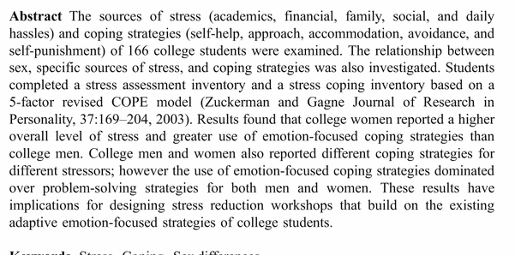
brougham
Stressor and strategy
Negative and its coping strategy
Academics
Financial
Family
Social
Daily hassles
Self-help
Approach
Accommodation
Avoidance
Self-punishment

Slide 5
Sources of stress and coping strategies
Sources:
Academics
Financial
Family
Social
Daily hassles
Coping Strategies:
Self-help
Approach
Accommodation
Avoidance
Self-punishment

Slide 6
Best way to study high-performance individuals with high health
Connect stressor to stress reduction
How to reduce different types of stress most effectively
This might be the best way to compile a playbook for stress reduction

Slide 7
For example
Stressor:
Academic deadline
Coping strategy:
Plan accordingly: break up the work thoughtfully, time management to complete the needed tasks
Reasoning, intellection

Slide 8
Example 2:
Stressor:
Get into a verbal dispute with a homeless person in a parking lot (starbucks)
Coping strategy:
Instinctual, behavioral, in the moment

Slide 9
Separate different stressors and handle them independently
Dispute -> workout, get the adrenaline out of your bloodstream
Read something online, sends your blood pressure up -> walk
Deadlines -> fun, go out, play golf, experience relief
Children -> time away, Netflix & chill (watch a video on your phone)

Slide 10
If -> then rubric
Talk to others about their coping strategies
What do you do when faced with typical stressors?
Study the most effective connections between stress and reduction
Advice others on the impact of the most effective strategies
Mental health pros can also capitalize
Creates a situation that we can study

Slide 11
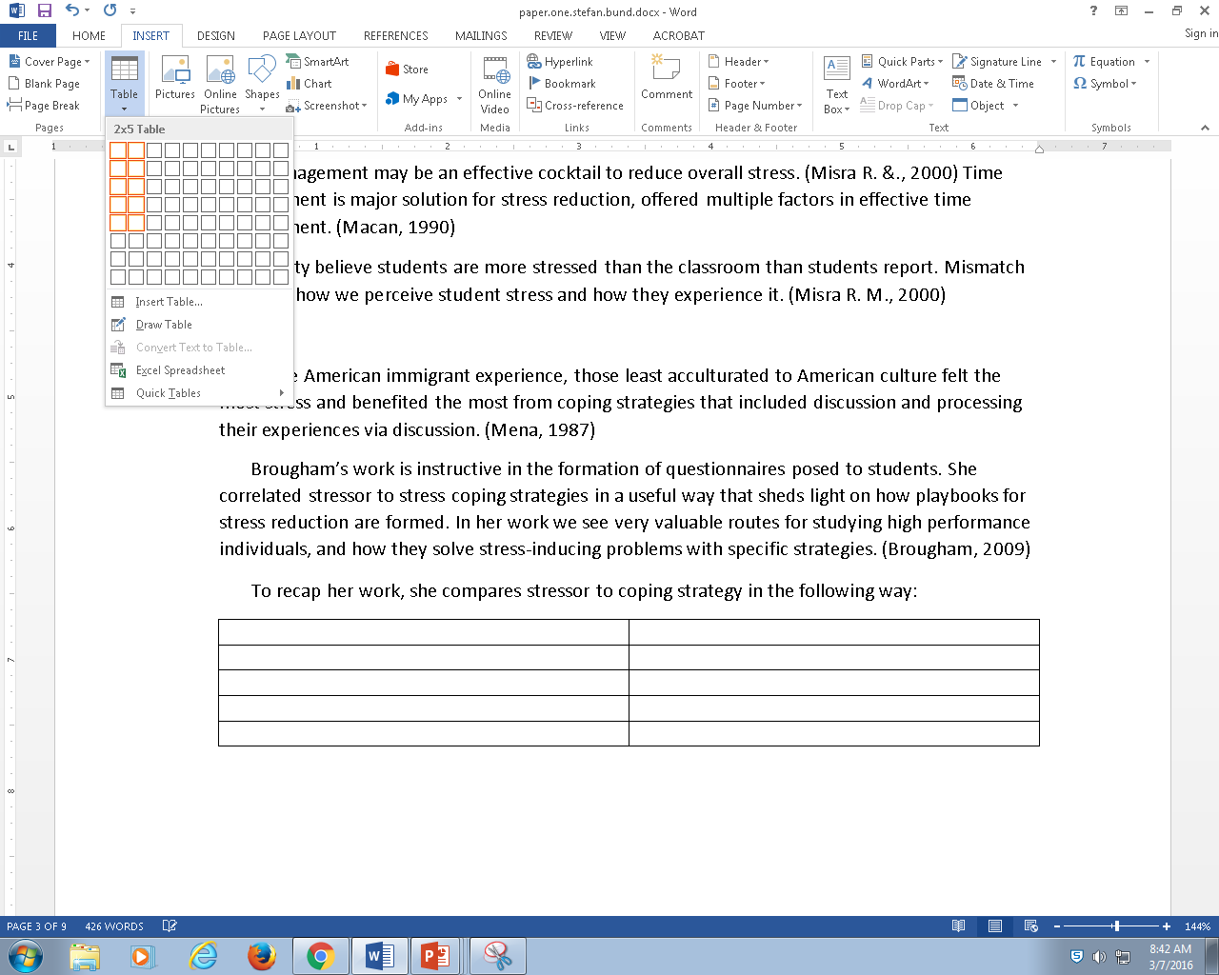
Add RB to our LS
Form a table to summarize her work

